Slide 1
Work Force Forecasting
Health Canada

Slide 2
Introduction team members
Venkata Mukesh Chadaram
Karthik Urala
Shailesh Gupta
Srinivas Kurakula
Dhruv Paramar

Slide 3
Objective
The objective of the presentation is to comprehensively understand the dynamics of organizational performance by delving into the details of various occupational groups and titles across the organization. By utilizing forecast data on a provincial scale, the analysis aims to provide deeper insights into how different roles and job titles within the workforce contribute to overall performance and productivity. This, in turn, enables strategic decision-making and resource allocation at a more nuanced level, supporting the organization in enhancing its performance and achieving its goals more effectively.

Slide 4
Problem Statement
Tracking workforce shortfall and hard-to-resource areas is vital for effective resource allocation.
Analyzing National Occupational Classification (NOC) code trends across Canada provides insights into growth and decline patterns.
Integrating NOC data with organizational forecasts is crucial for accurate staffing predictions.
The challenge lies in aligning NOC insights with internal needs, particularly in areas with challenging recruitment.
Proactive workforce planning based on this integration ensures organizational resilience and adaptability.

Slide 5
Data collection
During the data collection phase, we rely on Chris Thompson's HC Clean along with data sources found from Open Canada. This crucial step ensured the data collected for our outlook analysis was accurate, reliable, and consistent. By employing HC Clean, we streamlined the cleaning process, eliminating inconsistencies and errors present in the data. Simultaneously, leveraging data from Open Canada, which provided us with a comprehensive and diverse range of information to enrich our dataset.
Open Canada Data - 3-Year Employment Outlooks - Open Government Portal (canada.ca)

Slide 6
Attribute | Description | Data Type
ORGANIZATION_DESCR_EN | Company | String
BRANCH_DESCR_EN | Categories of branch of an organization | String
Province | Location | String
NOC_Description | Titles of the job | String
CAN_NOC_CD | Unique NOC Code | Integer
CLASSIFICATION_GROUP | Occupational Group | String
ID | Unique identifier of an employee | Integer
OUTLOOK | How well the job is performed over time. | String
OUTLOOK RATING | Rating based on job performance. | Integer

Slide 7
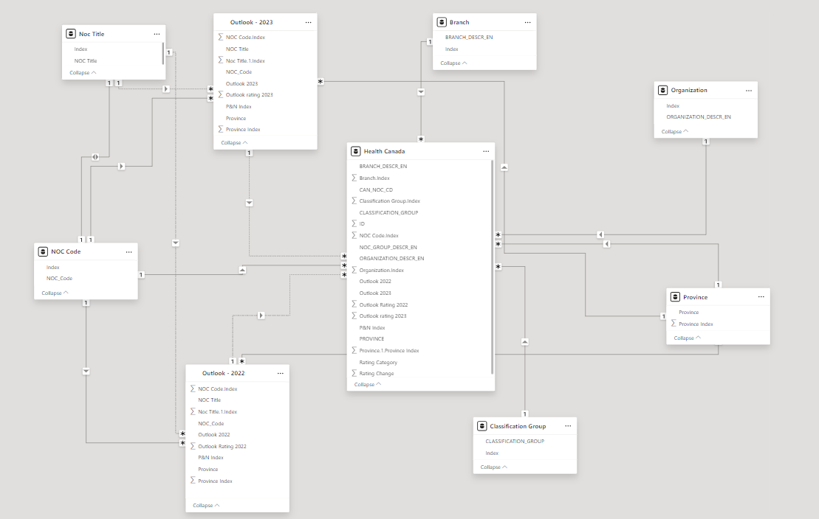
Data Modeling

Slide 8
Data Analysis
Branch Desc to Province as certain types of branches are more available in certain provinces and vice versa.
NOC Group Desc is directly proportional, for instance, healthcare services have higher demand, and it’s expected that NOC Group Desc related to the healthcare field will be more prevalent in those provinces.
Classification Group may vary with NOC Group Desc
Case 1: Certain Classification Groups encompass a wide range of NOC Group Desc where it is directly proportional.
Case 2: The other Classification Groups are narrowly defined and aligned with only a subset of NOC Group Desc.
Organizational Desc is directly proportional to Branch Desc because the organizational descriptions oversee branches with specialized functions or roles which implies there is a direct alignment between them.
NOC Group Desc is directly proportional to Classification Group because classification group are designed to categorize jobs based on NOC Group Desc and Classification Group.
Organization Desc may vary with Classification Group
Case 1: Certain Organizational descriptions consistently align with specific Classification Group which implies directly proportional.
Case 2: Whereas if there’s no clear alignment then it will be indirectly proportional.

Slide 9
Data Cleaning
In HC clean data, we identified and eliminated null values and incomplete entries.
We manipulated “undetermined” in Outlook data according to the HC Clean NOC_Desc.
Flexing structural errors by standardising data formats and units. This ensures consistency across the dataset.
We manipulated the “string” datatype of some variables to the “int” datatype.

Slide 10
Time series
Time series refers to a sequence of data points collected or recorded at successive time intervals, typically uniform in nature.
This dashboard on time series is helping us to analyze historical data on staffing levels. By identifying patterns and trends, we can make informed decisions about future staffing needs, resource allocation and strategic workforce planning.

Slide 11
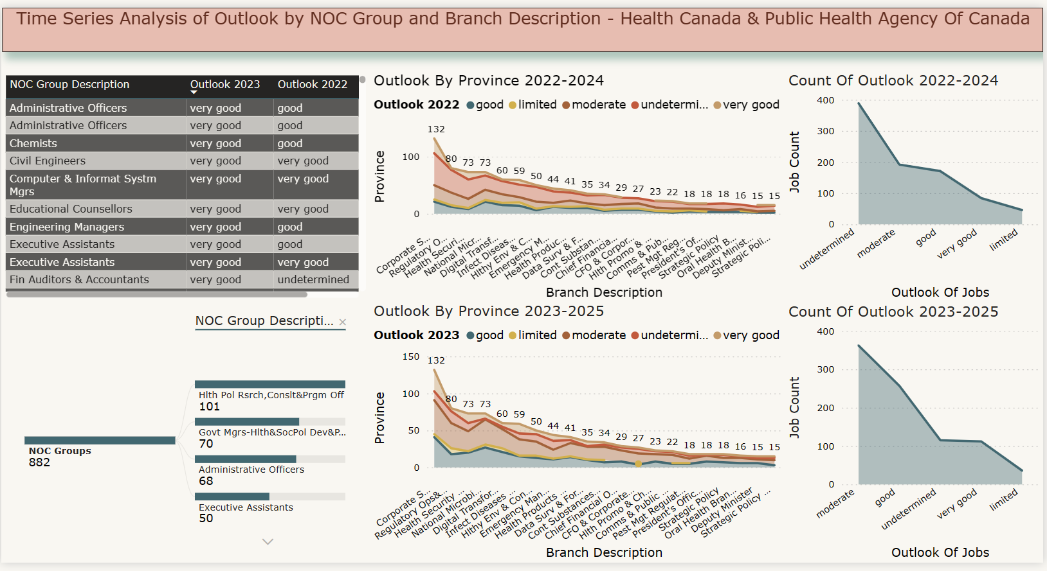
Time series

Slide 12
Insights / Observations
There is a positive trend in job outlooks from 2022 to 2023 among various NOC groups, indicating potential growth or stability in these sectors.
Provinces show a peak in "very good" outlooks around 2023, suggesting favorable conditions or initiatives that may be temporary or expected to change in subsequent years.
The overall decrease in the count of jobs across all outlook categories could indicate a contraction in workforce or a shift in job classifications over time.
The table on the left compares the job outlook in 2023 to 2022 for various NOC (National Occupational Classification) groups. Most groups are showing an improved outlook in 2023 compared to 2022, with many moving from "good" to "very good".
The presence of "very good" outlooks across several NOC groups suggests strong job prospects or positive performance metrics within these groups.

Slide 13
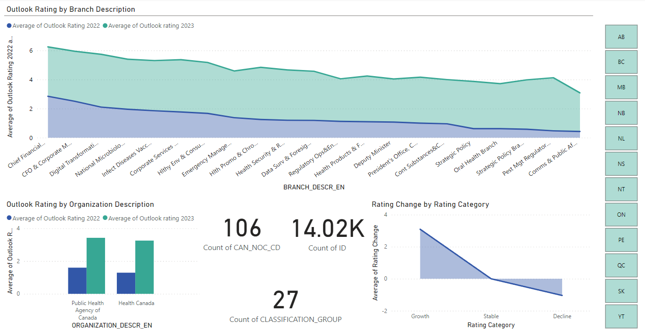
Departmental Analysis

Slide 14
Insights / Observations
The categories are color-coded at the bottom with the terms "Growth," "Stable," and "Decline," with Decline being the predominant category, based on the trend shown in the graph.
There is a sharp decline in the average of rating change, suggesting that most categories have seen a decrease in ratings.
The categories are color-coded at the bottom with the terms "Growth," "Stable," and "Decline," with Decline being the predominant category, based on the trend shown in the graph.
The entities have experienced a decrease in their outlook rating from 2022 to 2023, with the Public Health Agency of Canada having a slightly higher rating than Health Canada in both years.

Slide 15
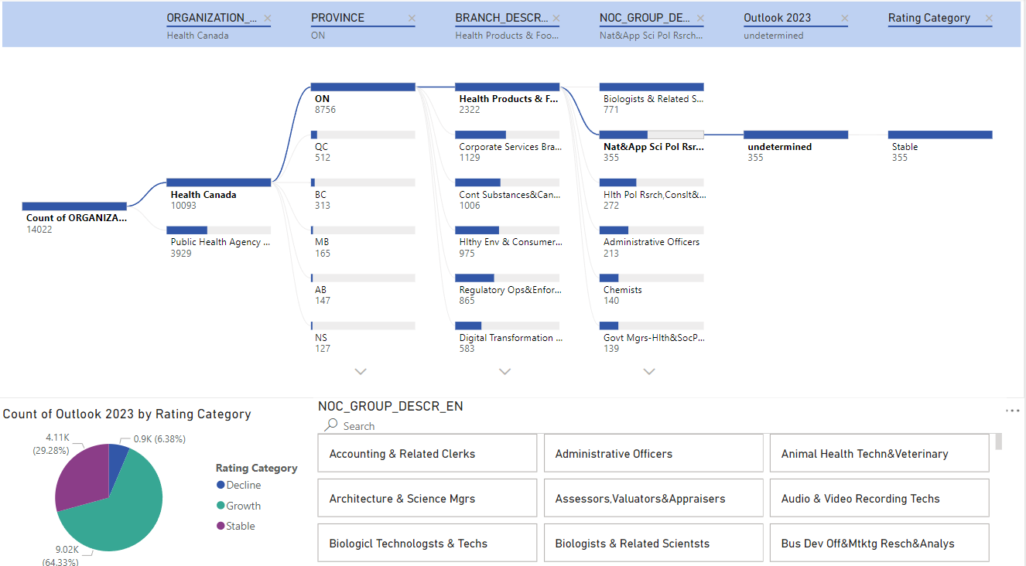
NOC Analysis

Slide 16
Insights / Observations
The pie chart shows the count of outlooks for 2023 categorized by rating: Decline, Growth, and Stable. A significant majority (64.33%) of outlooks are categorized as Stable, which indicates a large portion of the metrics measured are not expected to change significantly.
The top right corner shows a segmented distribution across various branches and NOC (National Occupational Classification) groups. The Health Products & Food Branch has the highest count (2,322) among the branches listed.
There is also a breakdown by province, with Ontario (ON) having the highest count (8,756), indicating the province with the most significant involvement or focus for these organizations.
Decline represents 29.28% of the outlook, which could be cause for concern, indicating that nearly a third of the outlooks are expected to worsen.

Slide 17
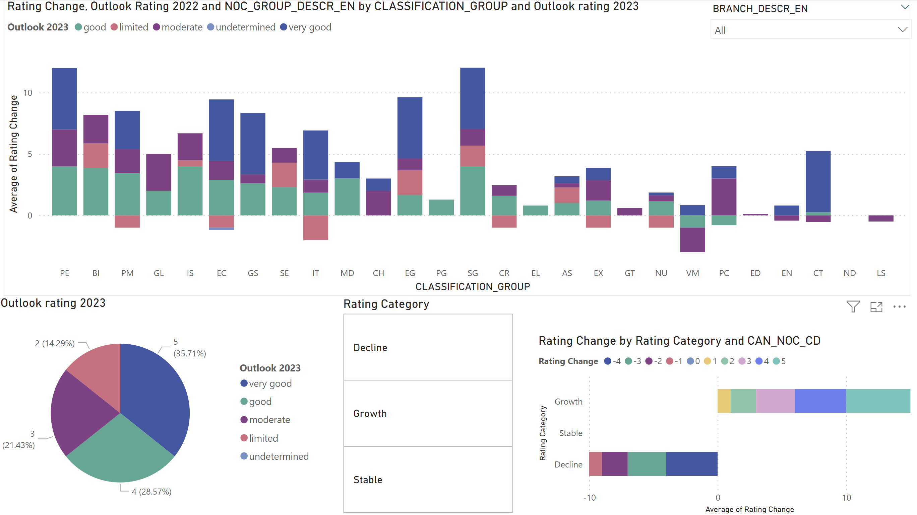
Classification_Group -Analysis

Slide 18
Insights / Observations
The pie chart shows the distribution of outlook ratings for 2023 with five categories: "very good," "good," "moderate," "limited," and "undetermined."
The largest segment is "moderate" at 35.71%, followed by "limited" at 28.57%, and "very good" being the smallest at 14.29%. This suggests that while there are concerns ("limited" ratings), most outlooks are not at the extremes of "very good" or "undetermined."
The horizontal bar chart shows the average of rating change broken down by three rating categories: "Decline," "Growth," and "Stable."
Most categories show a mix of growth and decline, but overall the "Stable" category seems to have the least amount of change, as indicated by the shorter bars.
The "Growth" and "Decline" categories exhibit significant variance, with some job codes experiencing substantial changes.

Slide 19
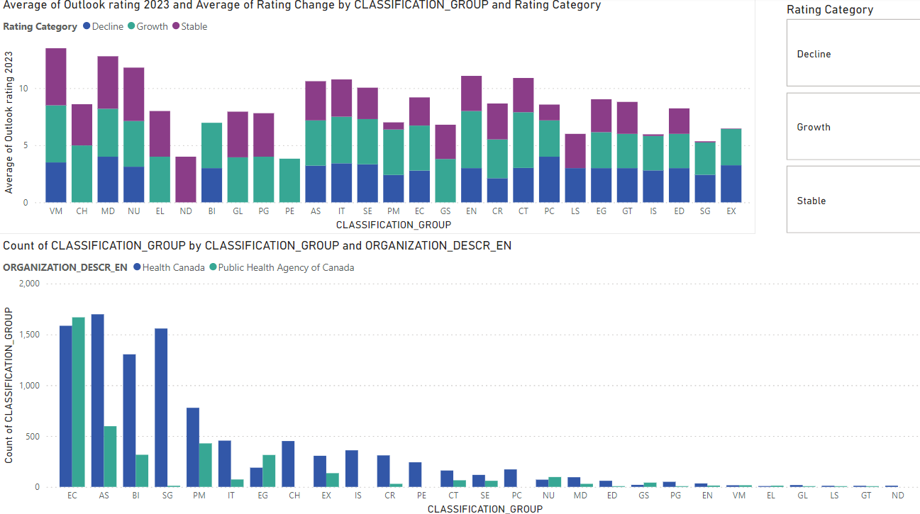
Detailed Classification Analysis

Slide 20
Insights / Observation
While some groups have a high outlook rating for 2023, the presence of decline within those same groups may indicate the need for careful management to sustain or improve their performance.
Health Canada has a larger variety of classification groups with substantial counts compared to the Public Health Agency of Canada, which could imply a broader scope of operations or more diverse functions within Health Canada.
The classification group with the code "VM" has the highest average outlook rating for 2023 but also includes a segment indicating decline.
The groups "MD," "SE," "IT," and "EG" also have high outlook ratings for 2023 but with a substantial part of their ratings in the decline category, suggesting a complex scenario where some aspects are expected to perform well, while others may face challenges.

Slide 21
Conclusion
By leveraging time series forecasting techniques, organizations can anticipate future workforce demands based on past trends, enabling proactive planning and resource allocation.
Integration of National Occupational Classification (NOC) data with internal forecasts has improved the accuracy of workforce planning, ensuring alignment between external labour market trends and internal staffing requirements.
This proactive approach to workforce planning facilitated by these methodologies enables organizations to address recruitment challenges preemptively, minimizing disruptions to operations.

